Slide 1



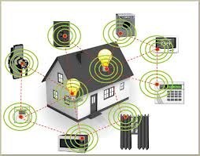
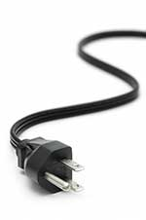
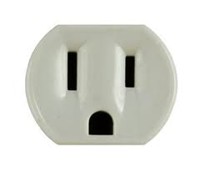
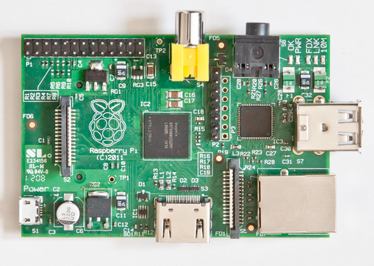
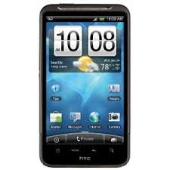
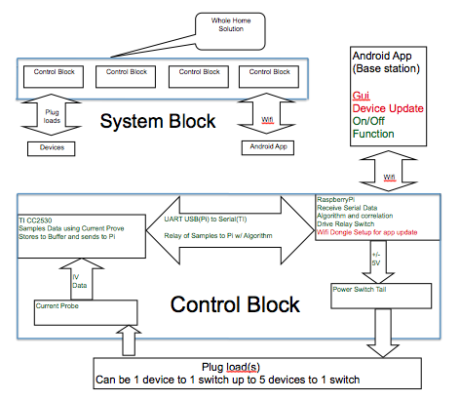
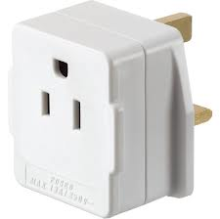

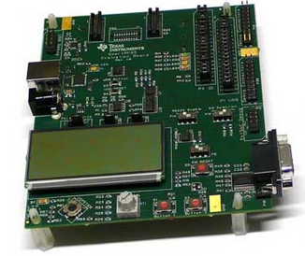
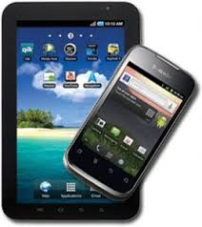
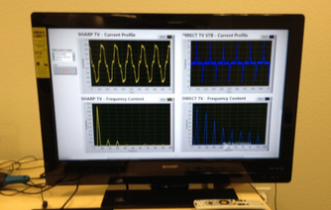
Intelli-Home Electronics Interpreter (IHEI)
Faraz Milani (EE), Kelvin Liang (EE), Young Min Kim (EE), Matthew Cai (CPE)
Our Goal
Plug Loads
Increase in Devices
Our Vision
We plan to design an energy
management system that will
minimize energy consumption
of plug load devices: appliances
or electronic devices that plug
into an electrical outlet.
Plug loads currently responsible for ~20% of electrical consumption in homes and buildings worldwide
From 1980 to present day, number of devices per U.S. home has gone from 3 to 25
Increase in devices means higher power consumption per American home
An IHEI integrated home
Close to zero energy wasted by idle devices
User-defined home energy management
This percentage is foreseen to grow to 30% by 2030 if energy management is not improved
We plan to present a time-lapse video of IHEI in action
Pressing need for energy conservation!
Phantom Power
Design Concept
System Architecture
Hardware Components
Phantom power is the power being consumed by a plug loads while it is idle or not in use
North America itself wastes $7 billion annually on phantom power
One of the main goals of IHEI is to cut down phantom power as much as possible
DSP Board
Raspberry Pi
Wall outlet
Outlet Adapter
DSP and
Microcontroller
Mobile
Device
Microcontroller controls current flow to outlet (on/off), and DSP allows plug load device recognition
Mobile app. serves as base station, displaying and controlling different recognized devices
TI CC2530
RPi Rev. 2
Connected to RPi
by Prolific serial to
USB
Equipped with SD
card and WiFi dongle
Automatic Waveform
Recognition
Mobile Application
Milestones
The Team
Android mobile app.
1/6: Have acquired all necessary materials to complete project
1/13: Demonstrate ability to switch outlet on and off without app.
1/20: Complete first draft of code for mobile app., UI completed
1/27: Finish debugging code for mobile app.
- Switch outlet on and off using mobile app.
2/3: Display user ability to set timers for switching outlet on/off using
mobile app.
- Begin user behavior algorithm
2/10: Begin testing for load recognition/waveform analysis
- Complete user behavior algorithm
- Begin model home integrated with IHEI
2/17: Complete testing for load recognition
- Complete user behavior algorithm
2/24: Finalize model home with integrated IHEI and test for the next week
3/3: Give oral presentation to industrial panel
3/10: Turn in final report
Group Leader: Faraz Milani
In charge of the overall progress of the project, system architecture, and keeping constant contact with advisor Arthur Zhang to ensure the success of our project.
Hardware Specialists: Kelvin Liang and Young Min Kim
Responsible for the hardware-related aspects of the project, such as interface between current sensors and microcontroller, digital signal processing, and soldering.
Software Specialist: Matthew Cai
In charge of programming tasks, such as creating the user interface for the mobile application and the main software of our project.
Advisor: Arthur Zhang, Technology Manager at California Plug Load Research Center, Calit2 Irvine
Contact: yzhang@calit2.uci.edu, milanif@uci.edu
IHEI will recognize plug loads based on current vs. time waveforms
2 Modes:
Developed algorithm which uses waveform data i.e. peak-to-peak and rise time, and implements cross-correlation
Manual Mode: User switches outlet on/off using app.
Timer Mode: User sets times for outlet to be on/off based on personal schedule
Advantage of recognition is that devices/outlets don’t need manual synchronization

